Slide 1
Everything about
Jute
By Deep
Grade 6-A
Roll no. 25

Slide 2
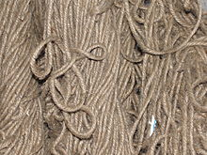
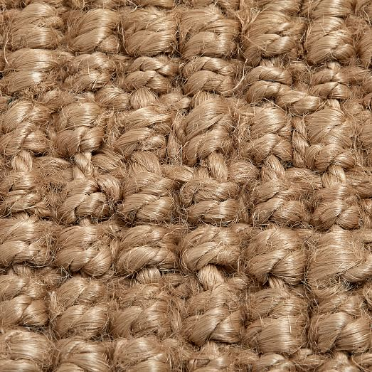
Information on Jute
Jute is a long, soft, shiny vegetable fiber that can be spun into coarse, strong threads.
Jute is the second most important vegetable fiber after cotton due to its versatility.
The fibers are also woven into curtains, chair coverings, carpets, area rugs, hessian cloth, and backing for linoleum.
The scientific name of jute is Corchorus capsularis
White jute and Tossa jute are one of the few examples

Slide 3
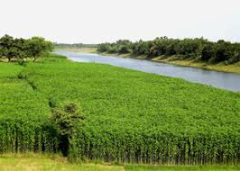
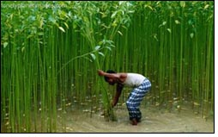
Climatic condition of jute
The suitable climate for growing jute is a warm and wet climate
It is grown mainly in the monsoon climate during the fall season, immediately followed by summer.
Temperatures ranging from 25-30 °C and relative humidity of 70%–90% are favorable for successful cultivation.
The perfect pH for growing Jute is 6 to 7.5

Slide 4
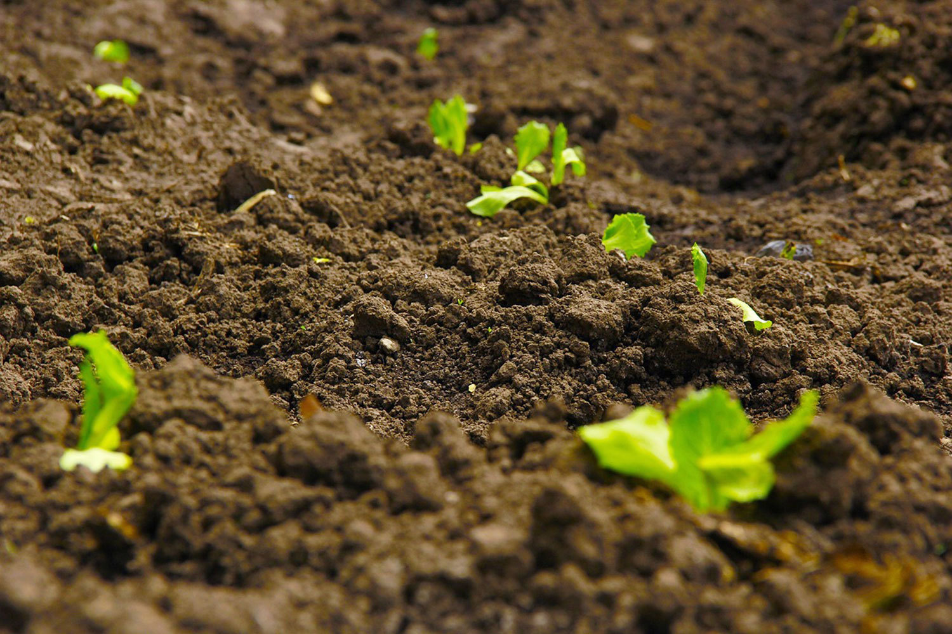
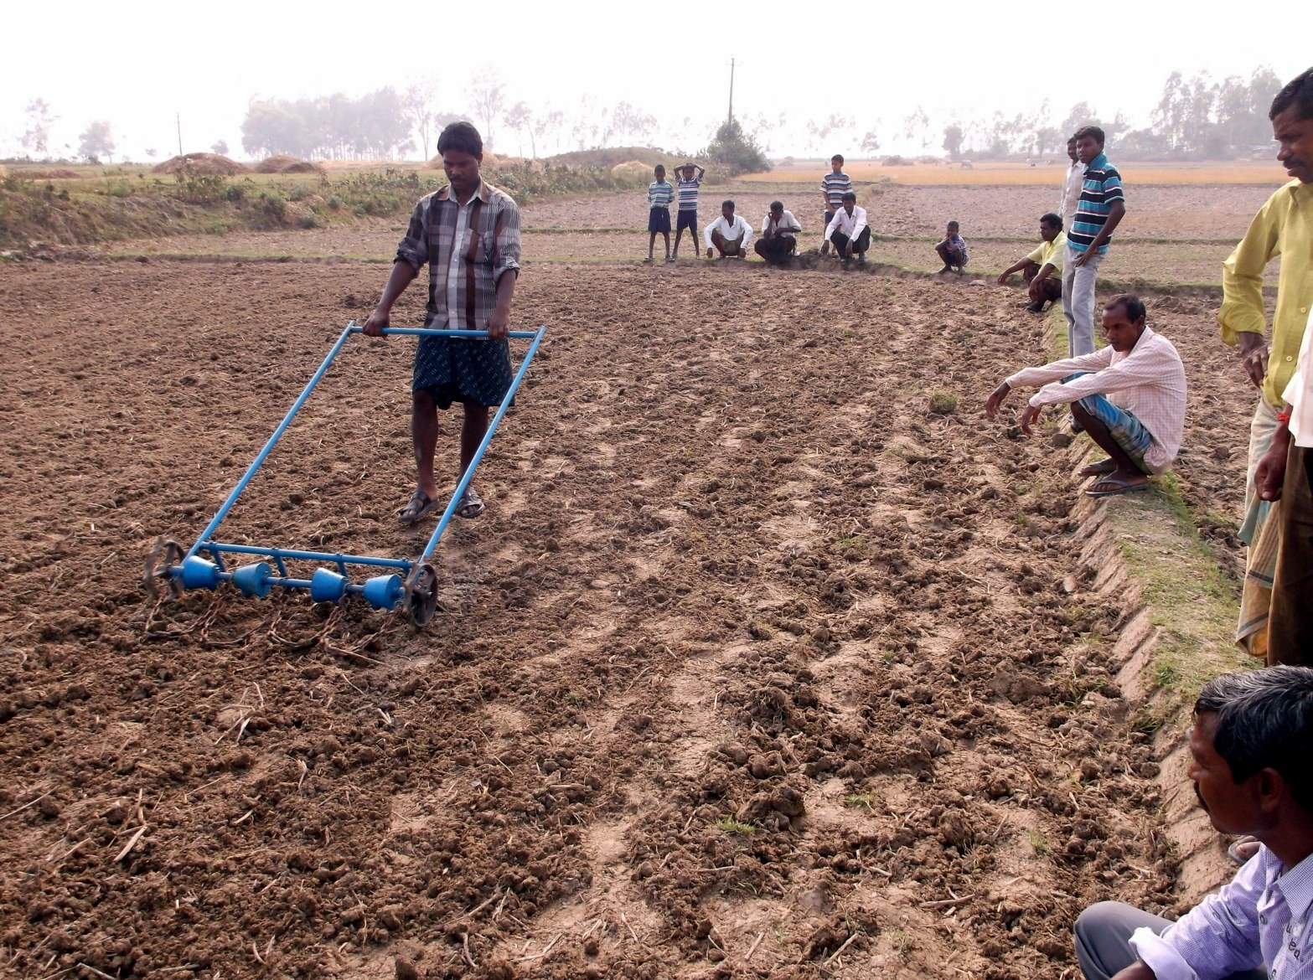
Soils that support Jute
The new gray alluvial soil of good depth, receiving salt from annual floods, is best for jute. Flow ever jute is grown widely in sandy loams and clay loams.
Jute is a rainy season crop, sown from March to May according to rainfall and type of land. It is harvested from June to September depending upon whether the sowings are early or late.

Slide 5
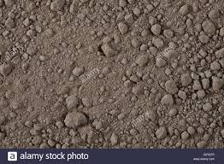
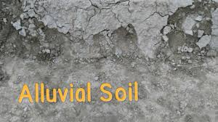
Soils
Grey Alluvial Soil
Grey Loam Soil

Slide 6
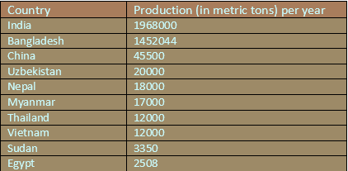
Top 10 countries growing Jute
Top 10 chart

Slide 7
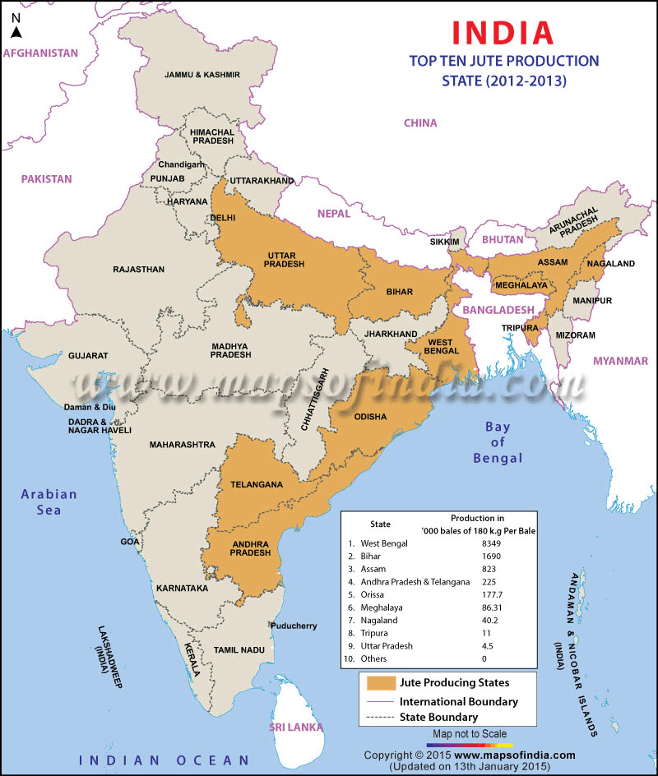
Areas in India Cultivating jute
The cultivation of jute in India is mainly confined to the eastern region of the country . The jute crop is grown in nearly 83 districts of seven states –
West Bengal
Assam
Orissa
Bihar
Uttar Pradesh
Tripura and Meghalaya
West Bengal alone accounts for over 50 percent raw jute production.

Slide 8


